Slide 1
Sentiment Analysis Using BERT and Multi-Instance Learning
Iryna Burak
Pablo Restrepo
July 20, 2020

Slide 2
Presentation Overview:
Project Overview
Monolingual Sentiment Analysis
Cross Lingual Sentiment Analysis
Two-class Sentiment Analysis
Conclusions
References

Slide 3
1. Project Overview
Data, methods and experiments

Slide 4

1.1 Project Goal
Develop a domain specific sentiment analysis model to predict sentence-level sentiment on social media comments on organic food products.

Slide 5
1.1 Project Goal
Example:
I really love the product. It is really tasty and healthy. The only downside is that it is expensive. I would definitely buy it again.
Overall sentiment of the comment: positive.
But there are still some sentences with negative sentiment.

Slide 6
1.2 Data used
Amazon EN, contains reviews in the categories:
Grocery and Gourmet Food
Health and Personal Care
Beauty
We filtered the reviews that contained the word “organic”.
Annotated Organic data:
Sentences about organic products annotated by domain experts.
Amazon DE: contains reviews in the categories:
Beauty
Grocery

Slide 7
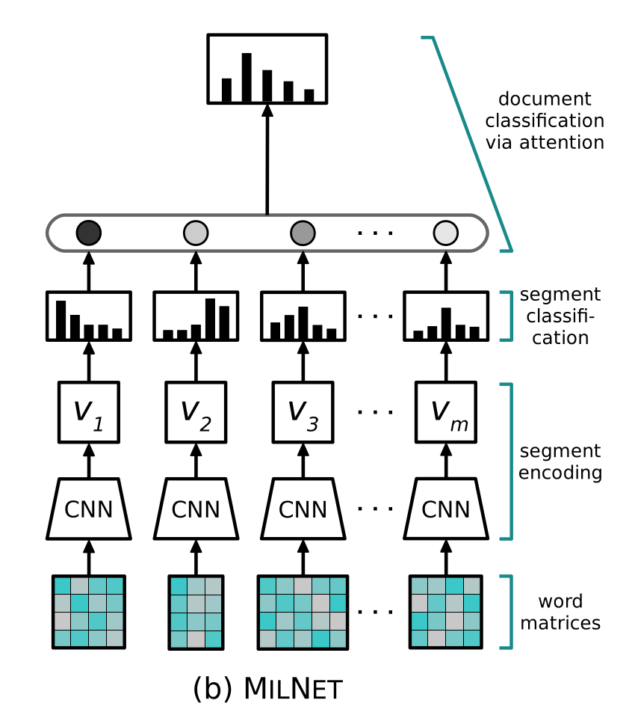
1.3 Tools and methods used
[1]
Multi Instance Learning Networks:
Predict segment sentiments
Get a document sentiment via attention
Compute the loss with respect to document-level labels only
Different embeddings as initial embeddings for our sentences and comments (BERT, RoBERTa, XLING).
Angelidis S. & Lapata M, Multiple Instance Learning Networks for Fine-Grained Sentiment Analysis, University of Edinburgh

Slide 8
1.4 Experiments
Train on | Fine-tune on | Test on
amazon EN | organic | organic
 |  | amazon EN
organic | - | organic
amazon EN | - | amazon EN
 |  | organic
 |  | amazon DE
Metrics: F1 scores (micro and macro)

Slide 9
1.5 Baselines
Baseline | English data | German data
Sentiwordnet | test | -
VADER | test | -
Textblob DE | - | test
NLTK Sentiment Analyzer (Naive Bayes) | train and test | -
Scikit-learn SVM model | train and test | -

Slide 10
2. Monolingual
Plots and first results

Slide 11
2.1 Embeddings used
We used BERT base uncased (monolingual) to generate initial embeddings for our data.
Pooling layer: -2
Pooling strategy: reduce mean

Slide 12
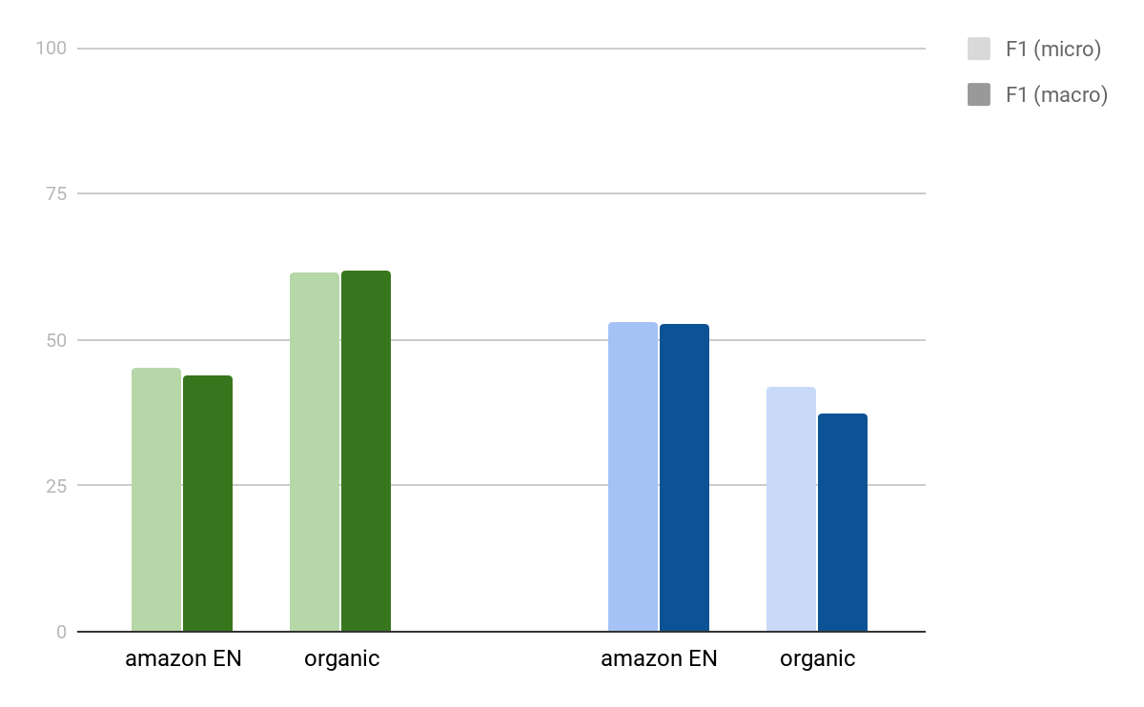
2.2 To fine-tune, or not to fine-tune
Training on amazon EN only leads to poor results for organic.
Fine-tuning on organic makes results for amazon EN significantly worse.
amazon EN and organic contain different types of comments and/or annotated in different ways.
trained on: amazon EN, embeddings: BERT base

Slide 13
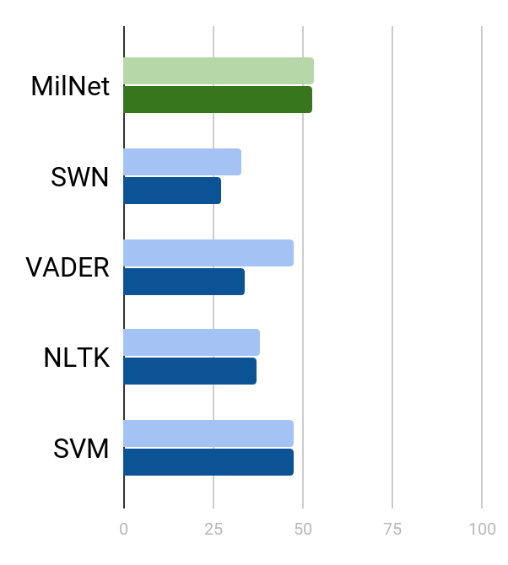
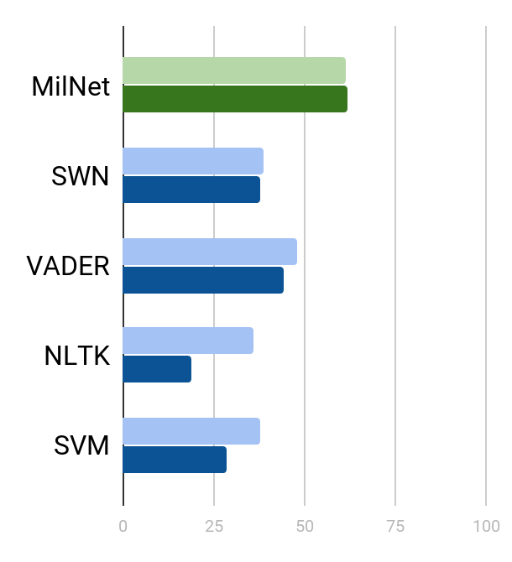
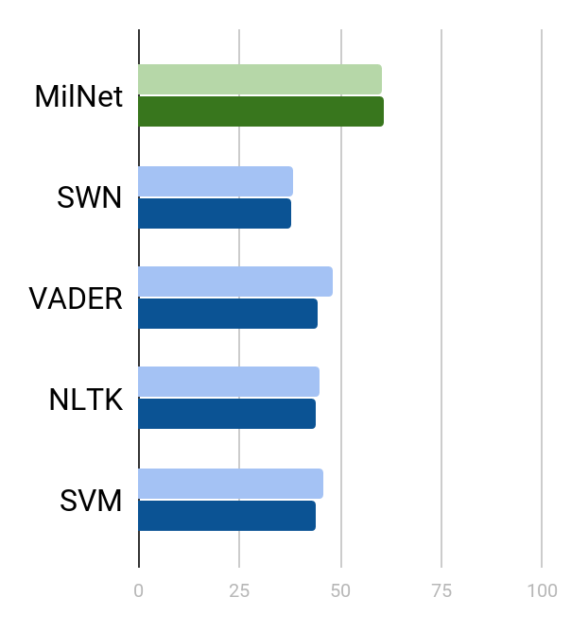
2.3 MilNet vs baselines
amazon EN to amazon EN
amazon EN to organic
organic to organic
F1 (micro)
F1 (macro)
SWN = Sentiwordnet

Slide 14
3. Cross-lingual
New embeddings and new results

Slide 15
3.1 Embeddings used
We used different multilingual embeddings:
BERT base multilingual cased.
RoBERTa
XLING
For BERT and RoBERTa:
Pooling layer: -2
Pooling strategy: reduce mean

Slide 16
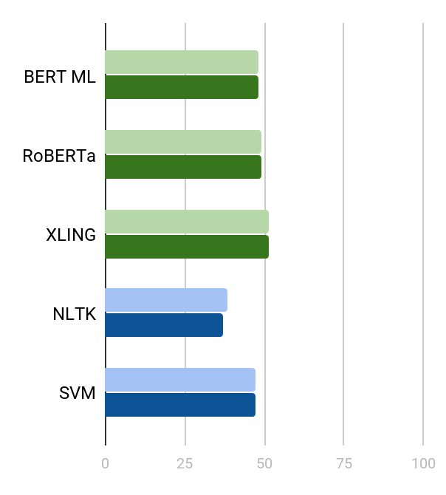
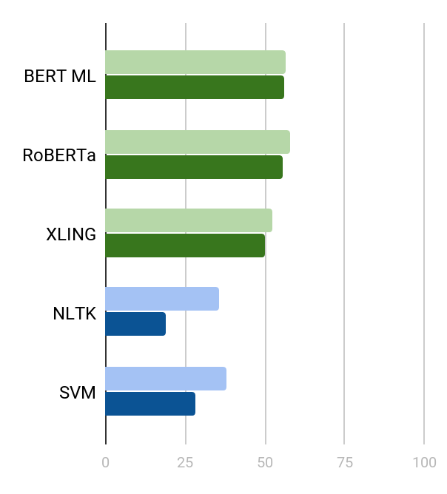
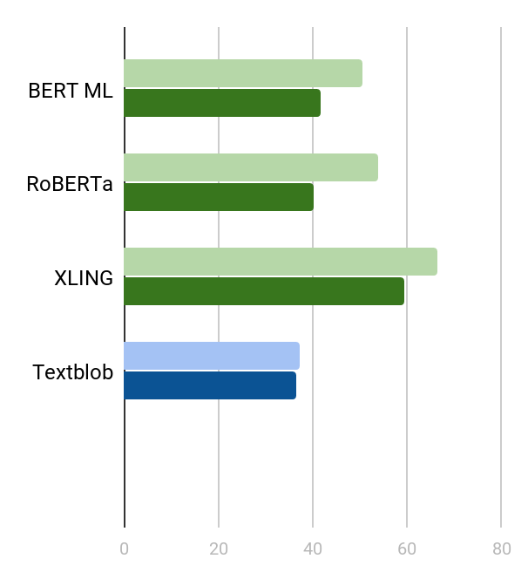
3.2 MilNet vs baselines
amazon EN to amazon EN
amazon EN to organic
amazon EN to amazon DE
F1 (micro)
F1 (macro)

Slide 17
3.3 Sentence-level context vs comment-level context embeddings
We generated embeddings for each token of the comment using the entire comment as context.
Example:
[[CLS],'I', 'really', 'love', 'the', 'product', '.', 'It', 'is', 'really', 'tas', '##ty',[SEP]]
Sentence 1 embeddings: mean of the tokens: 'I', 'really', 'love', 'the', 'product',
Sentence 2 embeddings: mean of the tokens: 'It', 'is', 'really', 'tas', '##ty'

Slide 18
3.3 Sentence-level context vs comment-level context embeddings
BERT can only handle sentences with a maximum of 510 tokens + [CLS] and [SEP].
Percentage of comments with more than 510 tokens: 9.3%
Number of sentences lost after removing comments with more than 510 tokens: (34%)

Slide 19
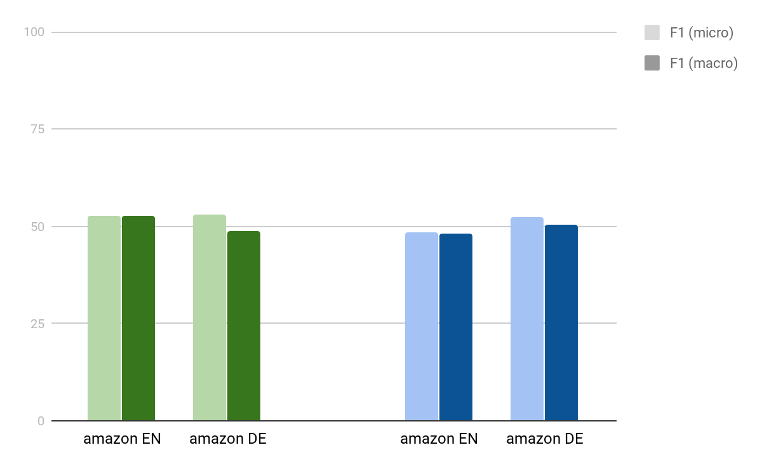
3.4 Comment-level vs sentence-level
To use comment-level context, we need to throw away large part of the data.
But comment-level context helps a little bit with the classification.
trained on: amazon EN, embeddings: BERT multilingual

Slide 20
4. Two-class analysis
More plots and even better results

Slide 21
3.1 Motivation
Neutral sentiment confuses the model.
If the model is unsure about the decision, it predicts neutral sentiment.
Confusion matrix
True | - | 0 | +
- | 154 | 67 | 12
0 | 70 | 174 | 44
+ | 46 | 55 | 141
experiment: amazon EN to organic, embeddings: BERT base

Slide 22
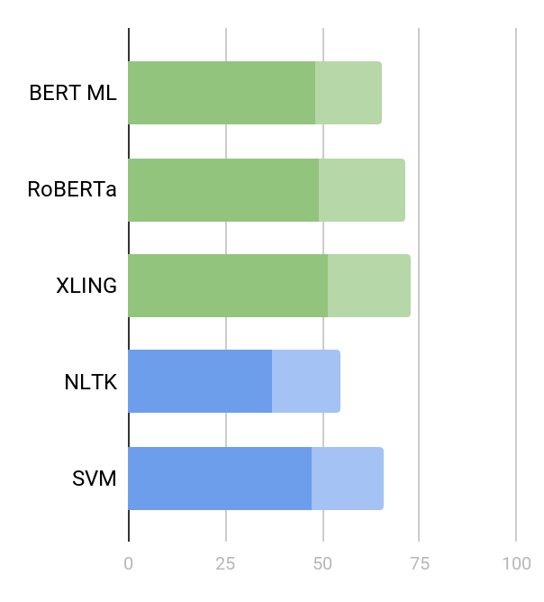
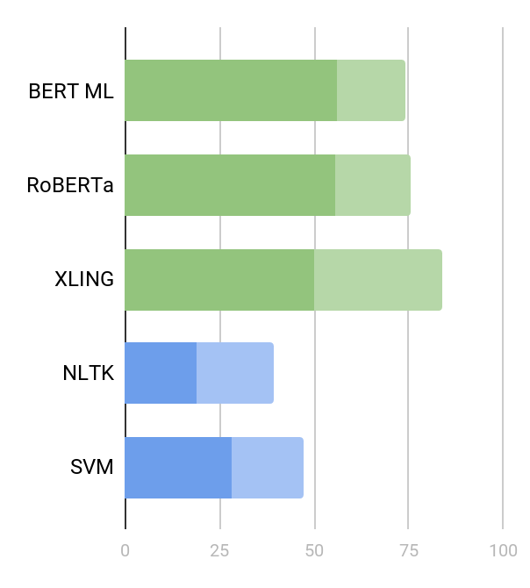
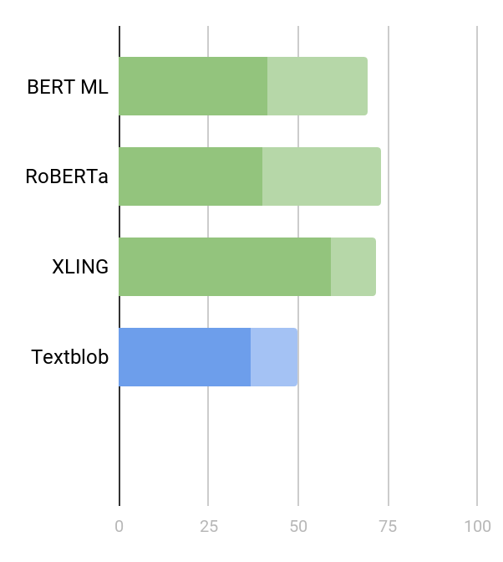
3.2 MilNet vs baselines
amazon EN to amazon EN
amazon EN to organic
amazon EN to amazon DE
3 classes: F1 (macro)
2 classes: F1 (macro)

Slide 23
5. Conclusions
The end

Slide 24
5.1 Conclusions
MilNet works!
The results for German data are better (possibly, Germans are just more explicit in their writing).
In our setting, using the entire comment as context did not help a lot, but that result is not necessarily generalizable.
In our setting, XLING was the best best choice for embeddings, but that result is not necessarily generalizable as well.

Slide 25
5.2 Conclusions
Neutral sentiment was difficult for our models, but also for baselines!
Models choose neutral when unsure, but people also do this.
Amazon data doesn’t use all the power of MilNet.
We don’t have sentence-level labels, only comment-level labels.
That is probably why organic gave better results than amazon.
Amazon and organic datasets are different.
Even though datasets come from the same domain, they don’t help with analysis of each other.

Slide 26
6. References
[1] Angelidis S. & Lapata M, Multiple Instance Learning Networks for Fine-Grained Sentiment Analysis, Institute for Language, Cognition and Computation School of Informatics, University of Edinburgh.

Slide 27
Thanks!

